Slide 1


Python Powered Stock Market Analytics with MongoDB, PySpark and Tableau
Presenters:
Akhilesh Akoju
Almas Fathimah
Rupesh Koram

Slide 2
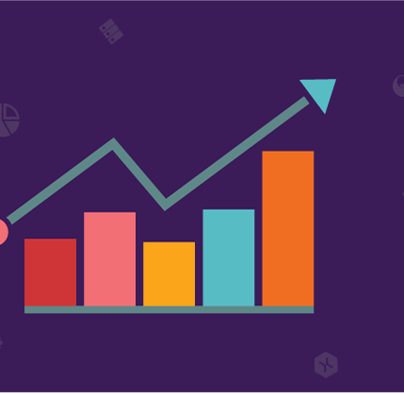
Introduction:
Stock market analysis is a method of evaluating and understanding the stock market, either for individual stocks or the market as a whole. The primary goal is to forecast future market behavior and make informed investment decisions. In your project, leveraging big data technologies like MongoDB, PySpark, and Tableau adds significant value and capabilities.
The evaluation of market trends is a fundamental aspect of stock market analysis. It involves identifying and interpreting patterns in the market, which can be upward, downward, or sideways. Analysts study these trends to predict the future direction of stock prices

Slide 3

Project Objectives
"Offering strategic entry and exit points for investment to a brokerage firm by interpreting data visualizations in Tableau, which are generated after conducting the following analyses:
Initial exploration of the dataset to understand underlying patterns and also did sector Wise Analysis.
Analyzing patterns that occur at regular intervals (seasonality) and long-term repetitive patterns (cyclic trends).
Executing technical analysis by observing the direction of the stock movement over short (30 days) and long (365 days) periods, trading volumes, price instability, and momentum indicators such as the Moving Average Convergence Divergence (MACD)."

Slide 4

Data Sources and Collection:
Data Sources:
Data from kaggle https://www.kaggle.com/datasets/paultimothymooney/stock-market-data
Free API's provided by tewlve-data https://twelve-data1.p.rapidapi.com/
Free API's provided by yh-finance https://yh-finance-complete.p.rapidapi.com/
Data Collection Methods:
Our primary data originates from CSV files, complemented by stock data obtained through API keys sourced from Alpha Vantage and Yahoo Finance.
Combined information from CSV files and APIs, smoothly blending both datasets into MongoDB Atlas. Now, we have a consolidated database ready for thorough analysis and smarter business moves.
Established a connection to Databricks using the MongoDB Connector, enabling comprehensive data analysis.
Facilitated smooth data transfer to Tableau, enhancing visualization and exploration capabilities.
Challenges Faced : data quality, api reliability, Rate limiting.

Slide 5



Tools and Technologies used:
MongoDB ATLAS: As a NoSQL database, MongoDB is excellent for handling large volumes of data, which is common in stock market analysis. It's flexible and allows for the efficient storage and retrieval of varied data types that are typical in the stock market, such as time series data, real-time data feeds, and historical records.
PySpark: PySpark, the Python API for Apache Spark, is instrumental in handling large-scale data processing. In the context of stock market analysis, PySpark can be used to process and analyze large datasets quickly. It's particularly useful for complex computational tasks like algorithmic trading, predictive analysis, and pattern recognition in large datasets.
Tableau: Tableau is a powerful data visualization tool. In stock market analysis, visualizations are crucial for interpreting complex data and identifying trends, patterns, and correlations.
Databricks: Databricks is a data and AI company that offers a unified data analytics platform. It is designed to make it easier for businesses to work with large amounts of data in a collaborative and interactive environment.

Slide 6
Architecture
Data Source (CSV,
JSON )
Data Ingestion
Data Visualization
(Tableau)
Data Query Layer & Analysis
(Pyspark)
Data Processing Layer
(Python)
Data Storage Layer
MONGO DB ATLAS
MONGO DB ATLAS

Slide 7
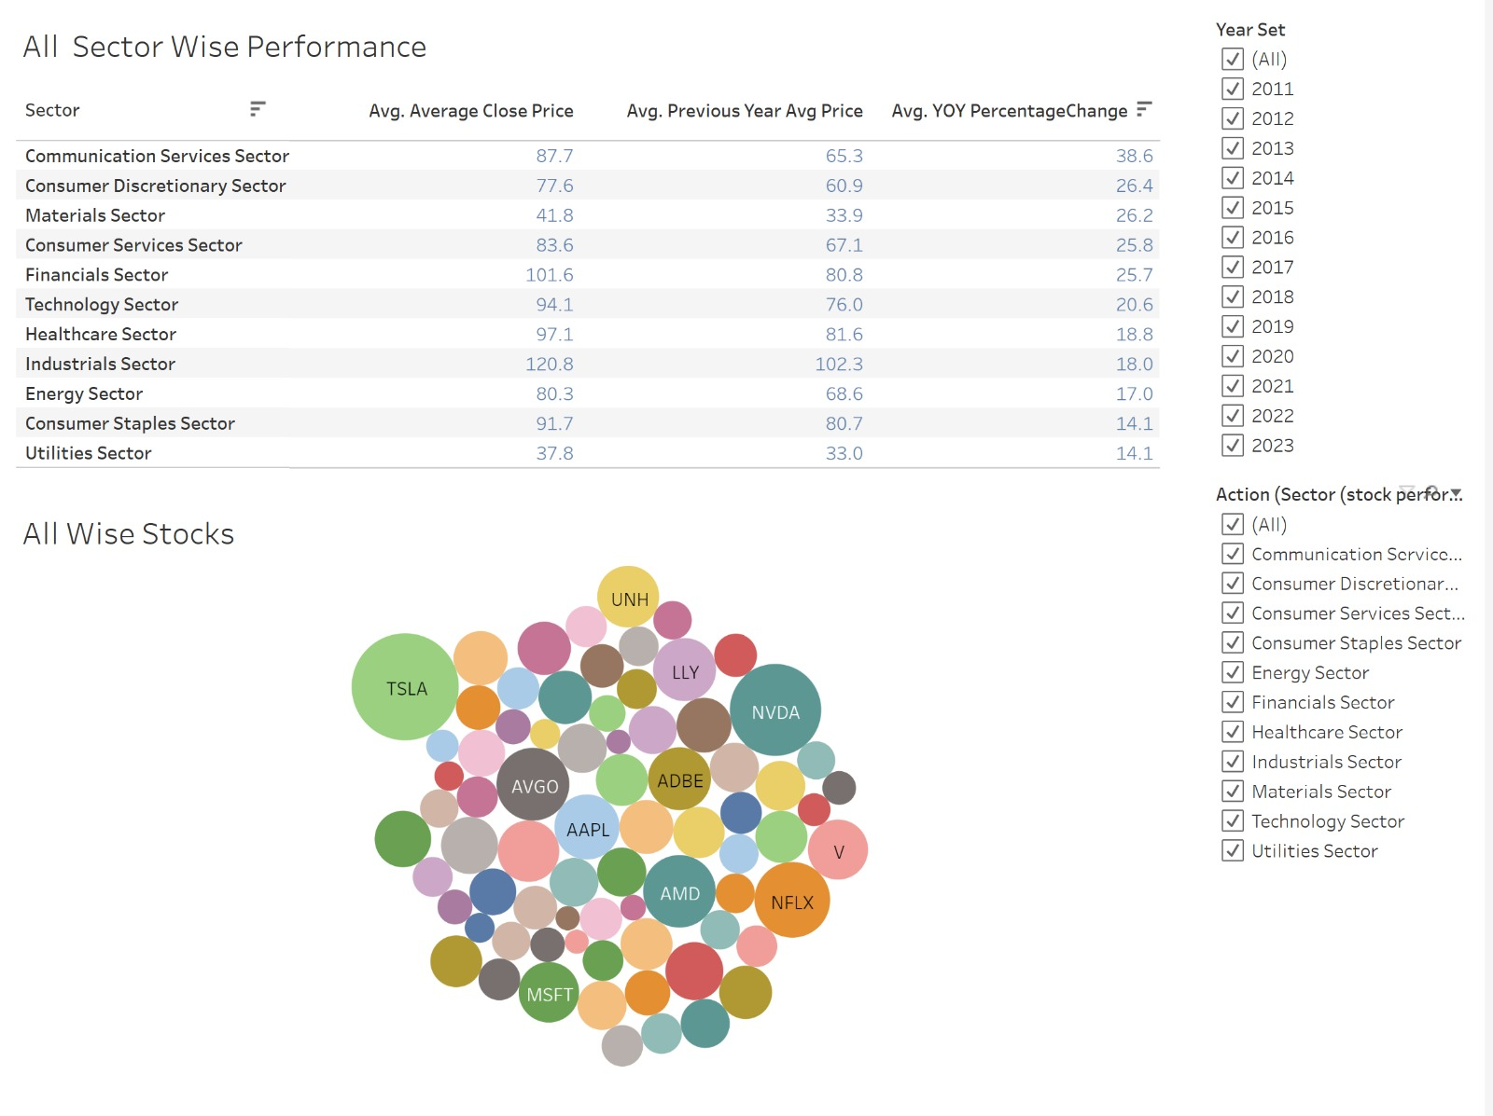
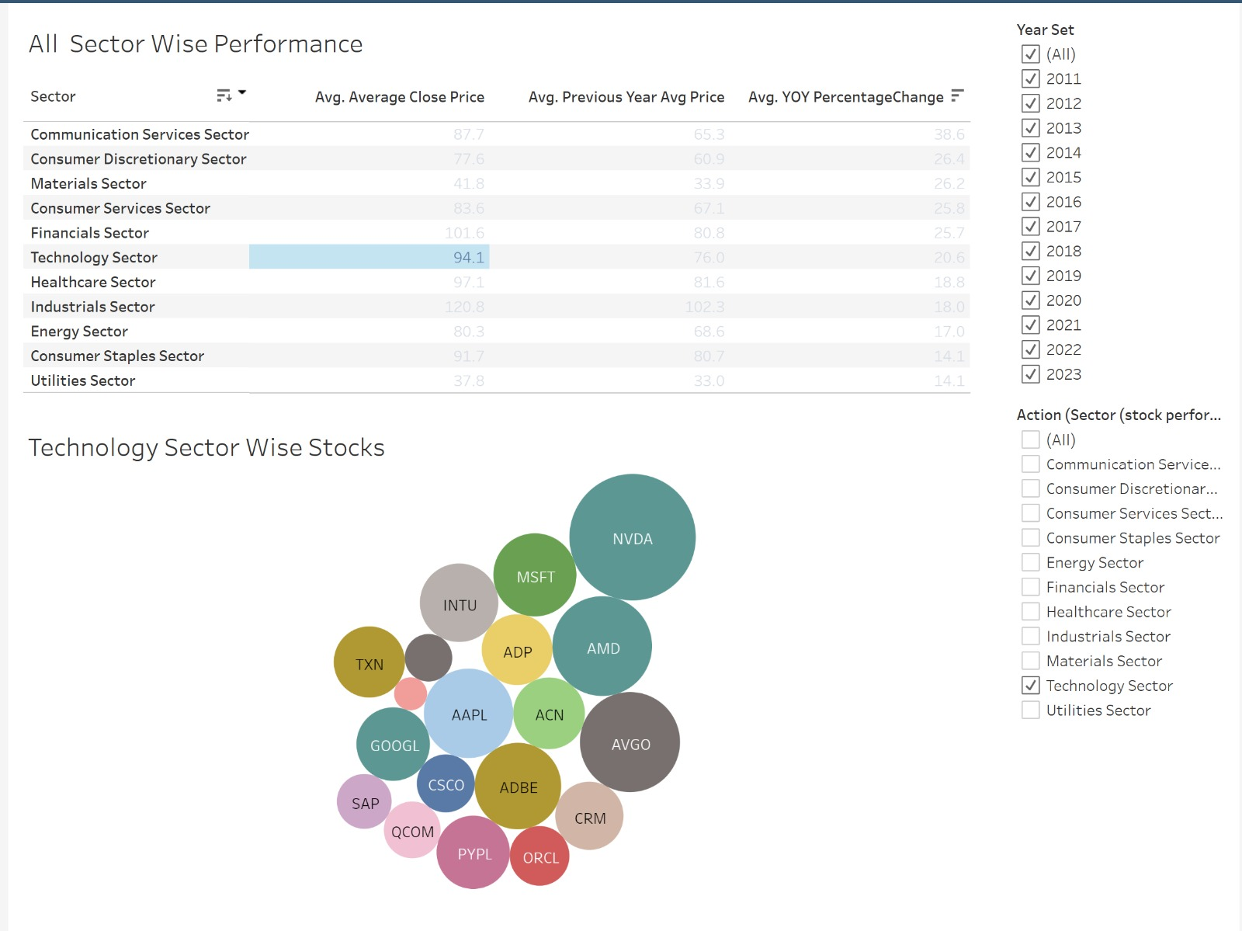
Sector wise Performance

Slide 8
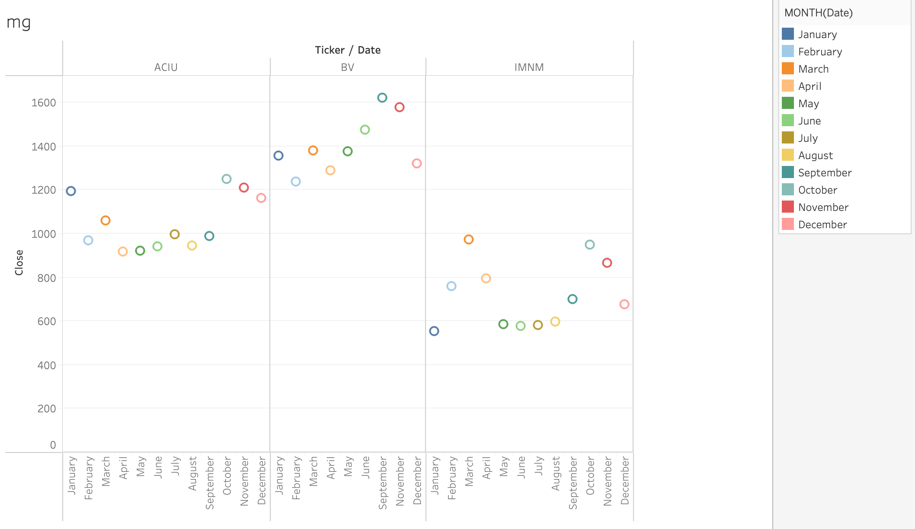
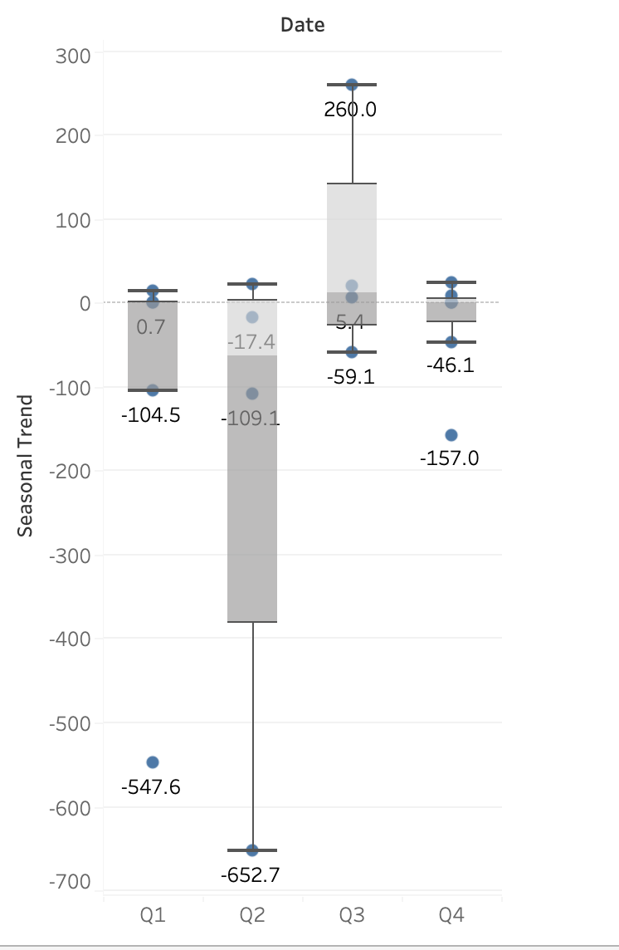
Seasonal and Stocks Trend:

Slide 9
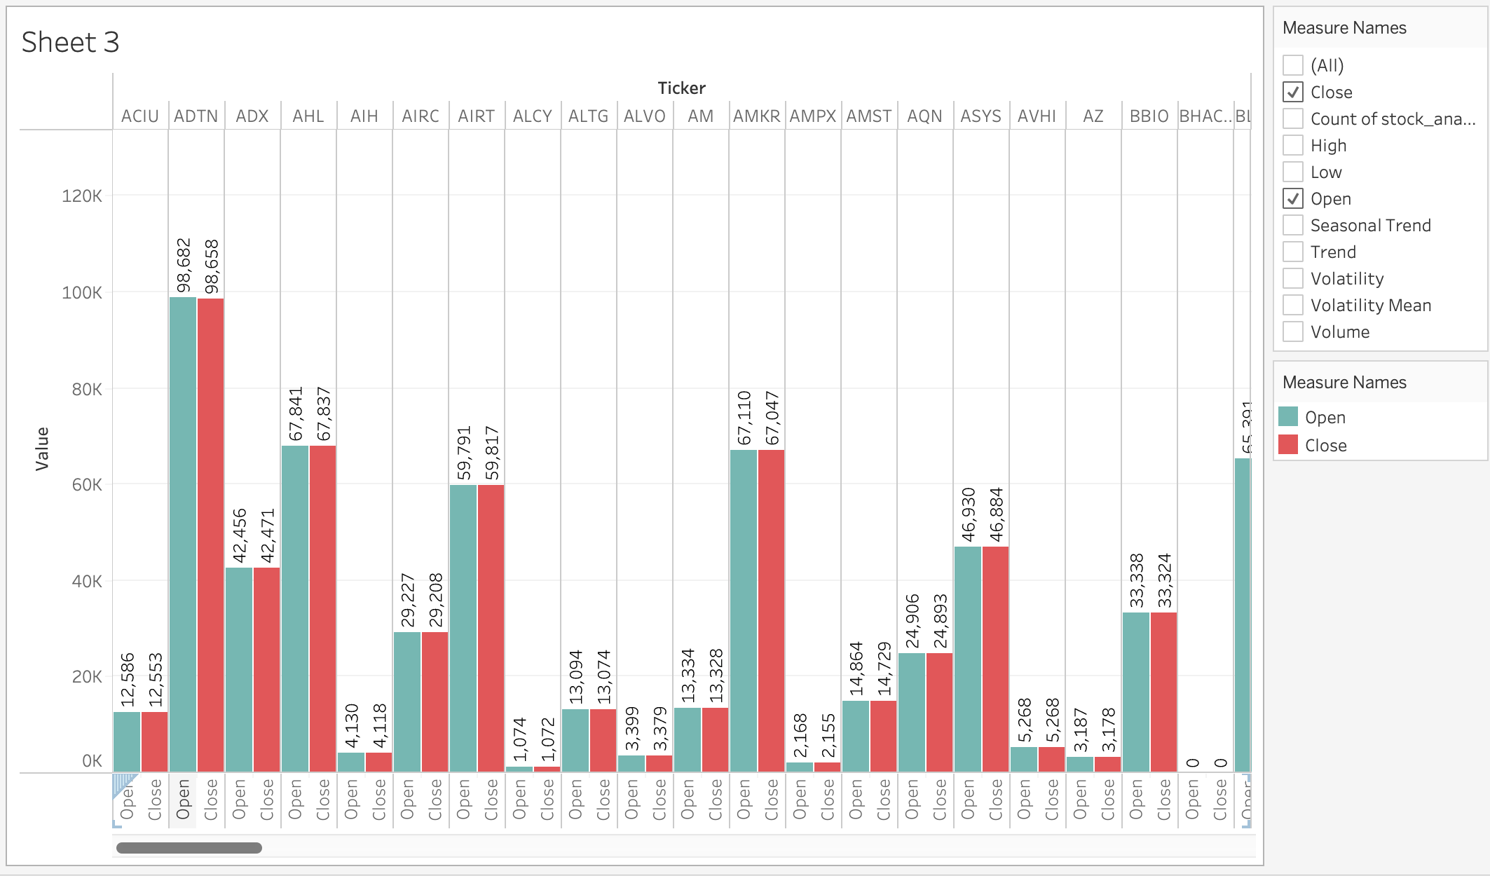
Comparing the open and close price for each stock:

Slide 10
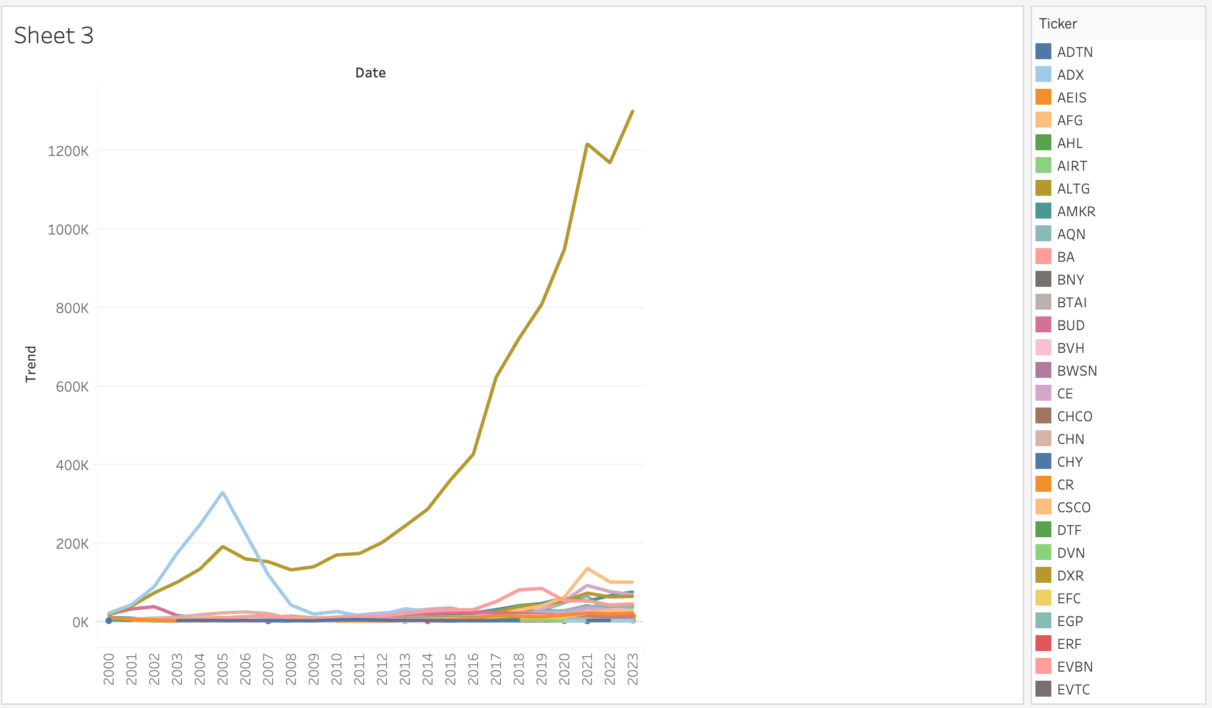
Year Wise Analysis of Each Stock:

Slide 11
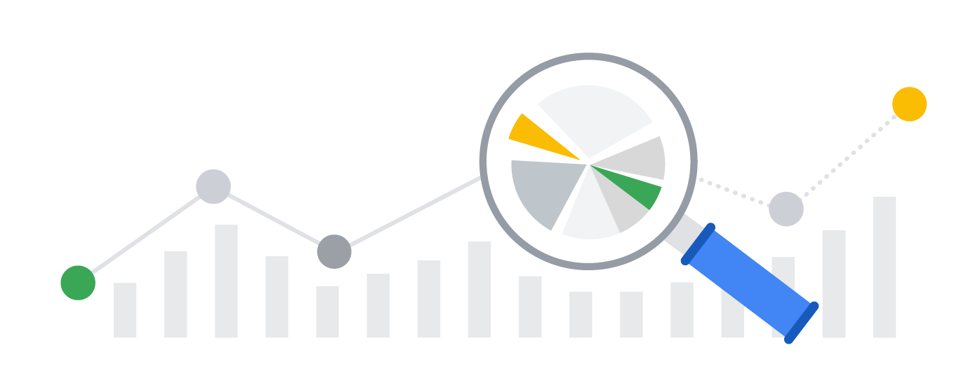
Insights and Report
Amidst the general decline across most sectors during the COVID period, notable post-pandemic trends emerged, showcasing robust recovery in sectors like Communication Service and Technology, which displayed significantly higher growth rates compared to others.
Better to buy stocks in Q2 and sell them in Q3.
Suggest firms in which company to invest when the closing price is significantly greater than opening price by using graphs.
Atlas equipment coporation is one of those companies whose trend is high in recent times.

Slide 12
Challenges
Data Overload: With the advent of big data, analysts are often overwhelmed by the sheer volume of information available, including market data, financial reports, news feeds, and social media content.
Market Volatility: Markets can be extremely volatile, influenced by myriad factors such as economic changes, political events, and global crises.
Technological Advancements and Adaptation: The fast pace of technological advancement requires continuous learning and adaptation. Analysts must stay updated with the latest tools and techniques.
Accuracy and Reliability of Predictive Models: There's a risk of creating models that are overfitted to past data, which may not accurately predict future market behavior.

Slide 13
Future Opportunities:
Advanced AI and Machine Learning: The ongoing development in AI and machine learning offers immense potential for more accurate predictive analytics, automated trading systems, and sophisticated risk management strategies.
Blockchain Technology: Blockchain could revolutionize stock market operations by enhancing transparency, reducing fraud, and streamlining transactions.
Quantum Computing: With its ability to process vast amounts of data at unprecedented speeds, quantum computing could enable more complex and rapid analysis, significantly impacting trading strategies and market predictions.
Increased Data Accessibility: As data becomes more accessible, there will be opportunities for deeper market insights and democratization of stock market analysis, allowing more players to participate effectively.

Slide 14
References:
Big Data in finance - your guide to financial data analysis. Talend. (n.d.). https://www.talend.com/resources/big-data-finance/
Deagon, B. (2022, September 14). Big Data Companies and data analytics: Stocks to buy and watch. Investor’s Business Daily. https://www.investors.com/news/technology/big-data-companies-data-analytics-stocks-to-watch/
Kalra, S., Gupta, S., & Prasad, J. S. (1970, January 1). Predicting trends of stock market using SVM: A big data analytics approach. SpringerLink. https://link.springer.com/chapter/10.1007/978-981-15-5827-6_4
Mallon, S. (2021, February 3). The massive impact of Big Data in the stock market. SmartData Collective. https://www.smartdatacollective.com/big-data-analytics-has-potential-to-massively-disrupt-stock-market/
Shen, J., & Shafiq, M. O. (2020, August 28). Short-term stock market price trend prediction using a comprehensive deep learning system - journal of big data. SpringerOpen. https://journalofbigdata.springeropen.com/articles/10.1186/s40537-020-00333-6
Trends, M. (2022, April 14). Data Analytics and stock trading: How to use Data Science in stock market analysis. Analytics Insight. https://www.analyticsinsight.net/data-analytics-and-stock-trading-how-to-use-data-science-in-stock-market-analysis/

Slide 15
THANK YOU

